Slide 1




Krishi Ai
Team ID – CU_CP_Team_8369
Jayesh Prajapati (Team Leader)
Dhrumil Rana
Vedant Solanki
Rajat Khairnar
Gautam Kshirsagar

Slide 2

Project Objectives
Problem Statement
Project Overview – Introduction
End Users
Wow Factor in Project
Modelling/Block Diagram/Flow of Project
Result/outcomes
Conclusion
Future Perspective

Slide 3
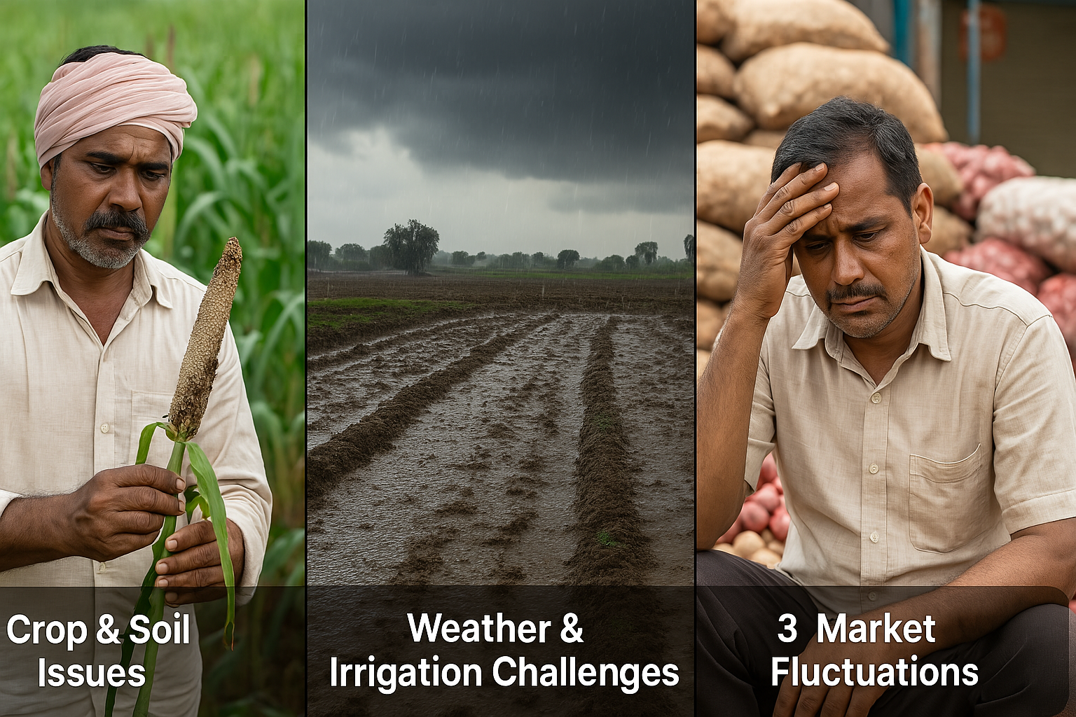
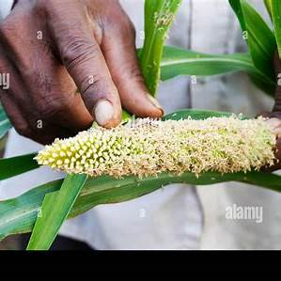
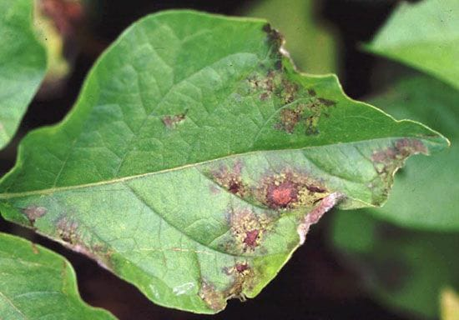
Problem Statement
Indian farmers face crop diseases, soil issues, weather risks, and price fluctuations, leading to losses. An AI-powered solution can help with smart, data-driven farming.
Crop & Soil Issues – Late disease detection and
poor soil health reduce yield.
Weather & Irrigation Challenges – Unpredictable rain, droughts,
and improper irrigation affect crops.
Market Fluctuations – Price instability leads to farmer
losses and financial risks.

Slide 4
Project overview - Introduction
Challenges in Indian Agriculture – Farmers struggle with crop diseases, soil degradation, unpredictable weather, and market price fluctuations, leading to low productivity and financial losses.
Krishi AI Solution – An AI-powered smart farming assistant using ML, AI, and IOT to provide real-time insights on crop health, soil analysis, weather forecasting, market prices, and smart irrigation.
Impact & Benefits – Helps farmers increase productivity, optimize resources, and improve financial stability, making agriculture more efficient and sustainable.

Slide 5
End User
Farmers – Small and large-scale farmers who need real-time insights for better crop management, soil health monitoring, and market price predictions.
Agricultural Experts & Extension Officers – Help farmers make informed decisions using AI-powered recommendations.
Government & Agri-Tech Companies – Use data for policy-making, improving agricultural productivity, and developing smart farming solutions.

Slide 6
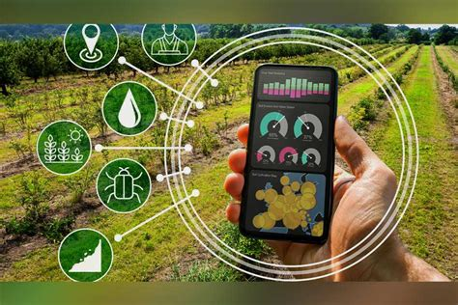
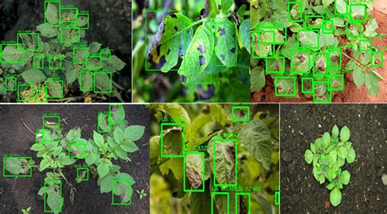
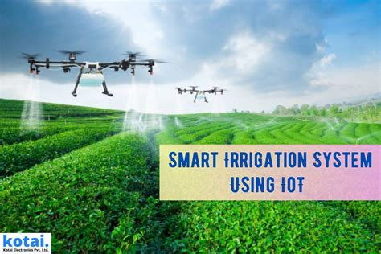
Wow Factor in Solution
Real-Time Crop Disease Detection (Just Click & Diagnose)
WOW: Farmers just click a photo of infected leaves — AI tells the
disease & gives treatment instantly.
AI-Based Fertilizer & Crop Recommendation
WOW: Based on soil test input, AI tells best crop + perfect
fertilizer mix – customized per farm!
Smart Irrigation with IoT Sensors
WOW: Soil moisture sensors + AI = auto irrigation only when
needed → water saved, yield boosted.

Slide 7
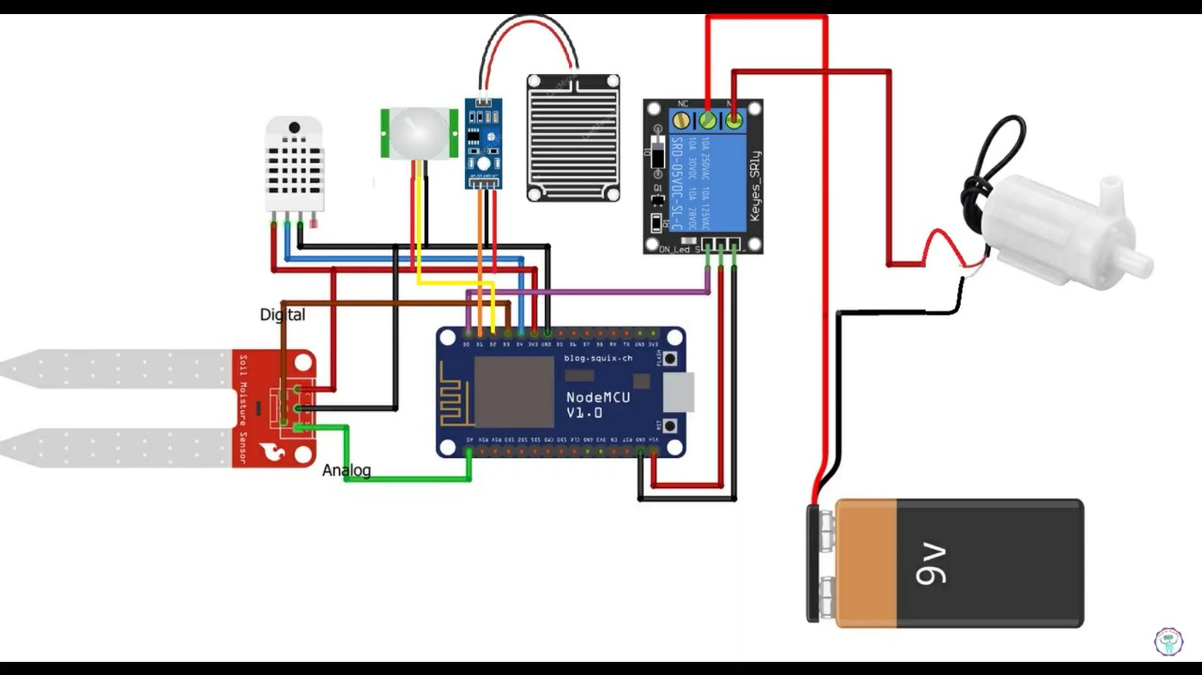
Modelling
Components Used:
ESP 8266 (Node MCU) – Main microcontroller with Wi-Fi for cloud integration
Soil Moisture Sensor (Analog + Digital) – Measures soil water content
DHT11 Sensor – Reads temperature & humidity
Rain Sensor – Detects rain to avoid unnecessary irrigation
Relay Module – Controls the water pump
Water Pump – Used for irrigation
9V Battery – Powers the pump

Slide 8
Machine Learning Models
1. Crop Recommendation - Based on soil and climate conditions
2. Fertilizer Recommendation - Suggests optimal fertilizer
3. Crop Price Prediction - Forecasts market price trends
4. Crop Disease Detection - Image-based diagnosis using ML/CNN

Slide 9
Web Application
Developed with FastAPI + HTML/CSS/JS
• Dashboard layout with cards for each model
• Real-time sensor data fetch and visualization
• Image upload feature for disease detection

Slide 10
Result / Outcomes
Results & Impact – Krishi AI: Empowering Indian Farmers with AI IN
Real-Time Intelligence. Real-World Impact.
Feature | Technology Used | Outcome
Crop Disease Detection | CNN, YOLOv8 | 92% accuracy in detecting 15+ crop diseases via image upload
Soil & Fertilizer Recommendation | Random Forest | 90% precision in suggesting best fertilizer & crop based on soil test
Weather Forecast & Smart Alerts | LSTM, ARIMA | Accurate 7-day prediction with alerts on rain, drought, heatwaves
Market Price Prediction | XGBoost, Prophet | Price forecast for 25+ crops with 87% reliability (low MAPE)
Smart Irrigation (IoT + ML) | NodeMCU, Sensors | Reduced water usage by 35% with automated irrigation logic
​

Slide 11
📊 Before vs After – Krishi AI Intervention
Metric | Traditional Farming | With Krishi AI
Water Wastage | High | Reduced by 35%
Fertilizer Usage | Guesswork | AI-Driven Recommendation
Crop Selection | Random / Experience-based | Soil & Market Optimized
Disease Detection | Late stage | Early, via image detection
Farmer Profitability | Unpredictable | Data-backed Planning

Slide 12
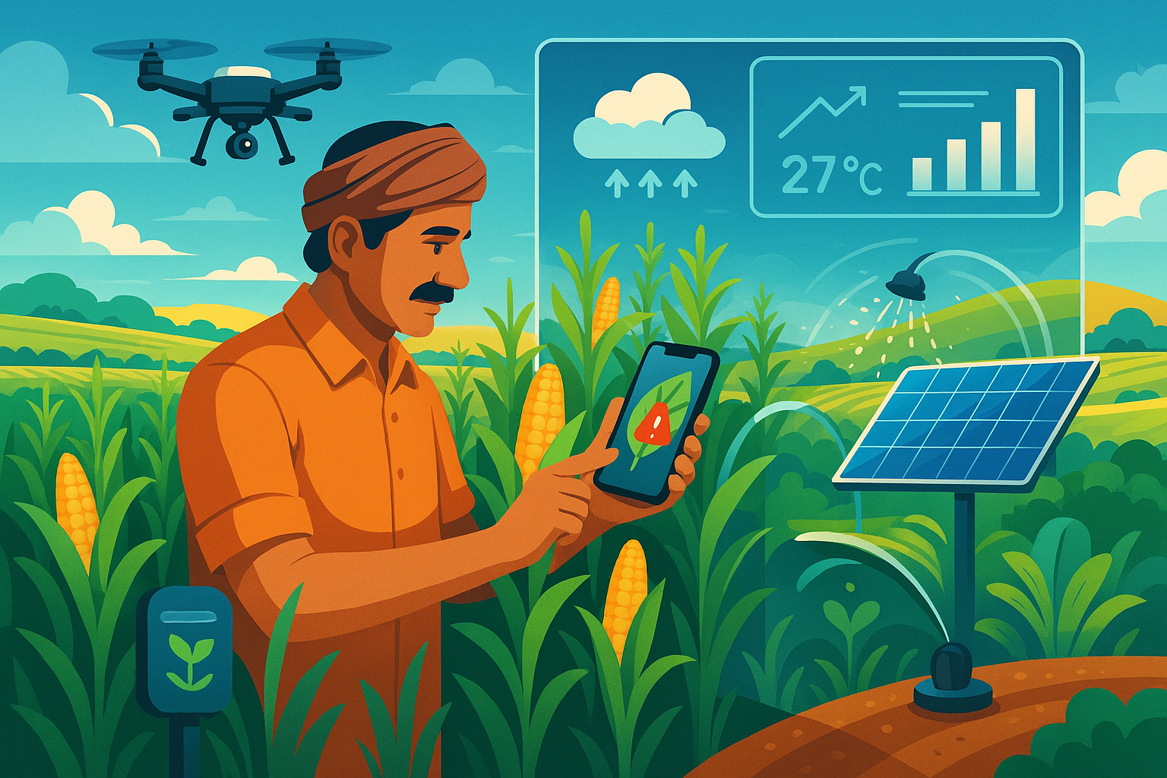
Future Perspective
Future Perspective – Krishi AI
Government Scheme Integration
Direct link to PM-KISAN, crop insurance, subsidies
Farmers get auto alerts for eligibility & deadlines
More Accurate Weather Prediction
Use AI + IoT data to forecast at micro-level
Early flood/drought warnings
Personalized Crop Planning AI
Suggest which crop to grow next season based on:
Soil health
Market trends
Weather patterns
Krishi AI Hardware Kit
Affordable plug-and-play sensor kits for small farmers
Mobile-connected with app integration

Slide 13
Conclusion
Summarize the Vision
“Krishi AI aims to empower Indian farmers with AI & IoT, helping them take smarter decisions for healthier
crops, better income, and a sustainable future.”
What We Solved
Crop disease detection in real-time
Soil health monitoring via IoT
Weather forecasting for timely planning
Market price prediction for better profit
Smart irrigation to conserve water
“Krishi AI – where technology meets the soil, to grow prosperity for every farmer in India.”

Slide 14
Thank you...!
Notes:
14

